Slide 1
FIELD PROJECT FLAVOUR BOX PRESENTED BY: BATCH -5 B.Kavya - 231FA04281 M.Susmitha - 231FA04342 P.K .Abhilash - 231FA04344 M.Prasanna - 231FA04354 V.Bindu - 231FA04382 PRESENTED TO :Mrs.V.NANDHINI

Slide 2

Introduction: In today’s fast-paced world, online food delivery services have become an essential part of daily life, providing convenience and variety to customers who want to enjoy delicious meals without leaving their homes. The "Flavour Box" online delivery service aims to simplify this process by offering an easy-to-use platform for users to explore and order a variety of food items, including Shawarma, Momos, Milkshakes, and more. This website provides a user-friendly interface designed to facilitate the ordering process, offering features such as a dynamic menu, an intuitive delivery form, and multiple ways to navigate between pages. The site includes a Home Page where customers can view featured products, a Menu Page showcasing various food types, and a Contact Us page for customer support. Using HTML for structure, CSS for design, and JavaScript for functionality, the website allows users to interact with the platform in real-time. JavaScript is used to dynamically display different product types, such as the various types of Shawarma and Milkshakes, based on the user’s selection. Users can also submit their orders through the delivery form, providing their contact information and preferred products. This platform is intended to serve as a basic model for an online food delivery service, with future plans for enhancements such as backend integration for order processing, user authentication, payment gateway integration, and real-time product availability. Ultimately, "Flavour Box" strives to offer a seamless online food ordering experience that brings the joy of fresh, flavorful meals right to the doorsteps of its customers.

Slide 3
Objective:
The primary objective of the "Flavour Box" online food delivery service website is to create a user-friendly, interactive platform that allows customers to easily explore, select, and order food items, such as Shawarma, Momos, Milkshakes, and other beverages, from the comfort of their homes. The specific goals of the project include:
Provide a Seamless User Experience: Develop an intuitive and responsive website that allows users to navigate through various sections, such as the homepage, menu page, and contact page, effortlessly.
Dynamic Product Display: Implement JavaScript functionality to dynamically showcase different types of food items (e.g., Shawarma, Momos, Milkshakes), allowing users to explore variations of each product based on their selection.
Enable Easy Order Placement: Create a simple and clear delivery form where users can enter their personal details, select products, and place orders efficiently. The form aims to collect necessary information like name, address, phone number, and selected products.
Facilitate Customer Interaction: Offer a Contact Us page with customer support details, providing users with easy access to email and phone information for any inquiries or assistance.
Foundation for Future Development: Lay the groundwork for future improvements, such as integrating a backend for order processing, adding user authentication for secure logins, and integrating payment options to allow for a more comprehensive online ordering system.
.

Slide 4
PRESENT SYSTEM:
Header Section:
Displays the name of the service (Flavour Box) and its location near a university gate.
Navigation (Nav):
Contains links to different pages on the site, including Login, Home, Menu, and Contact Us.
Login Page:
A simple login form with fields for entering email and password. The form is set up to submit data via the POST method but lacks backend integration.
Home Page:
Displays Featured Products, such as Shawarma, Momos, and Milk Shakes. Each item has an image (for Shawarma, the image source is provided locally, but for others, it's empty) and links that will show their specific types (e.g., Shawarma types).
Also includes a Delivery Form where users can provide their name, address, phone number, and select multiple products they want to order. The form has input fields and a multiple-choice dropdown to select products like Shawarma, Momos, MilkShakes, Mojitos, and Mocktails.
Menu Page:
Initially hidden and is shown when a user selects the Menu option. It dynamically displays the types of items available for Shawarma, Momos, and Milkshakes (more details below).
Contact Us Page:
Displays contact details, including email and phone number for the service.
Footer:
Contains a copyright message indicating the year and that only cash on delivery is accepted.

Slide 5
CSS Styling
General Styles:
Basic styling is applied to the body, header, and footer to make the website clean and responsive.
Header:
A dark background with white text for a strong, bold header.
Navigation:
Styled with a black background. Links change color when hovered over for better user interaction.
Product and Type Items:
Product Items are laid out using flex to display the items in a row. Each item is given a white background with a box shadow to create a card-like effect. Images are responsive.
Type Items are styled similarly but are used to display specific variations of products (like Shawarma types).
Forms:
Both the Delivery Form and Login Form are styled to have uniform input fields with padding, border, and radius for smooth interactions.

Slide 6
JavaScript Functions
Page Navigation (showHomePage, showMenuPage, etc.):
These functions toggle between different pages (Home, Menu, Contact Us, Login) by modifying their display properties, ensuring that only one page is visible at a time.
Product Type Display (showShawarmaTypes, showMomosTypes, showMilkShakesTypes):
These functions are used to show the types of different products (e.g., Shawarma, Momos, Milkshakes). When a user clicks on a product name (e.g., Shawarma), the corresponding function is triggered to dynamically create and display the available types for that product on the Menu Page.
Shawarma Types include options like "Chicken Shawarma", "Special Chicken Shawarma", etc.
Momos Types include "Steamed Momos", "Fried Momos", and "Tandoori Momos".
Milkshake Types include "Chocolate Milkshake", "Oreo Milkshake", "Strawberry Milkshake", etc.
Functionality and Flow:
Login:
The login form is static and requires backend integration to function fully. It currently only collects email and password.
Order Placement:
The Delivery Form lets users select products and fill out their delivery details. Although the form doesn't submit to a backend, it could be extended to connect to a server for processing orders.
Menu Interaction:
The Menu page dynamically updates when the user clicks on product categories (Shawarma, Momos, or Milkshakes). It uses JavaScript to update the available types of each product.

Slide 7
How the Website Works:
When users visit the website, they see the Home Page with featured products like Shawarma, Momos, and Milk Shakes. They can click on each to explore further types available for those products.
They can Login to the site (though this is a static form currently).
Contact Us provides the company's contact information.
Users can place an order through the Delivery Form by selecting products and entering their delivery details.
Areas for Improvement:
Image Sources: Some product images are missing in the HTML (src="" for Momos and Milk Shakes). These need valid URLs or paths to work properly.
Backend Integration: The forms (Login and Order) don't currently connect to a backend. Integrating with a server or database would allow the website to process user logins and store order details.
Responsiveness: While the code uses basic responsive design principles (like the viewport meta tag and flexbox), additional improvements could be made for mobile users, such as adjusting the layout or font sizes for different screen sizes.

Slide 8
Possible Enhancements:
Image Gallery: Add proper images for Momos and Milkshakes.
Real-time Availability: Show real-time availability of products or menu updates (through JavaScript or API integration).
Order Confirmation: After submitting the delivery form, users could receive an order confirmation, ideally with tracking information.
Payment Gateway: Integrate an online payment option (even if the site mentions Cash on Delivery, providing payment options is beneficial).
Authentication System: Implement a backend for user login functionality (e.g., using sessions or tokens).

Slide 9
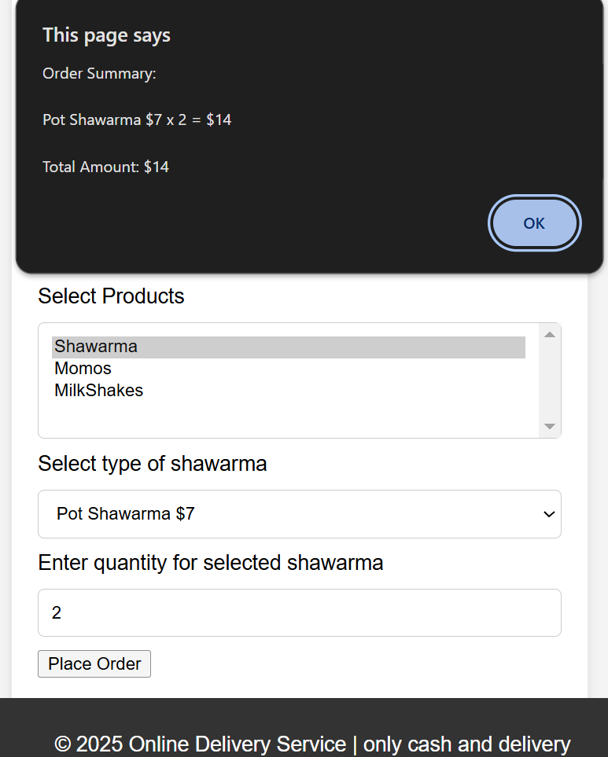
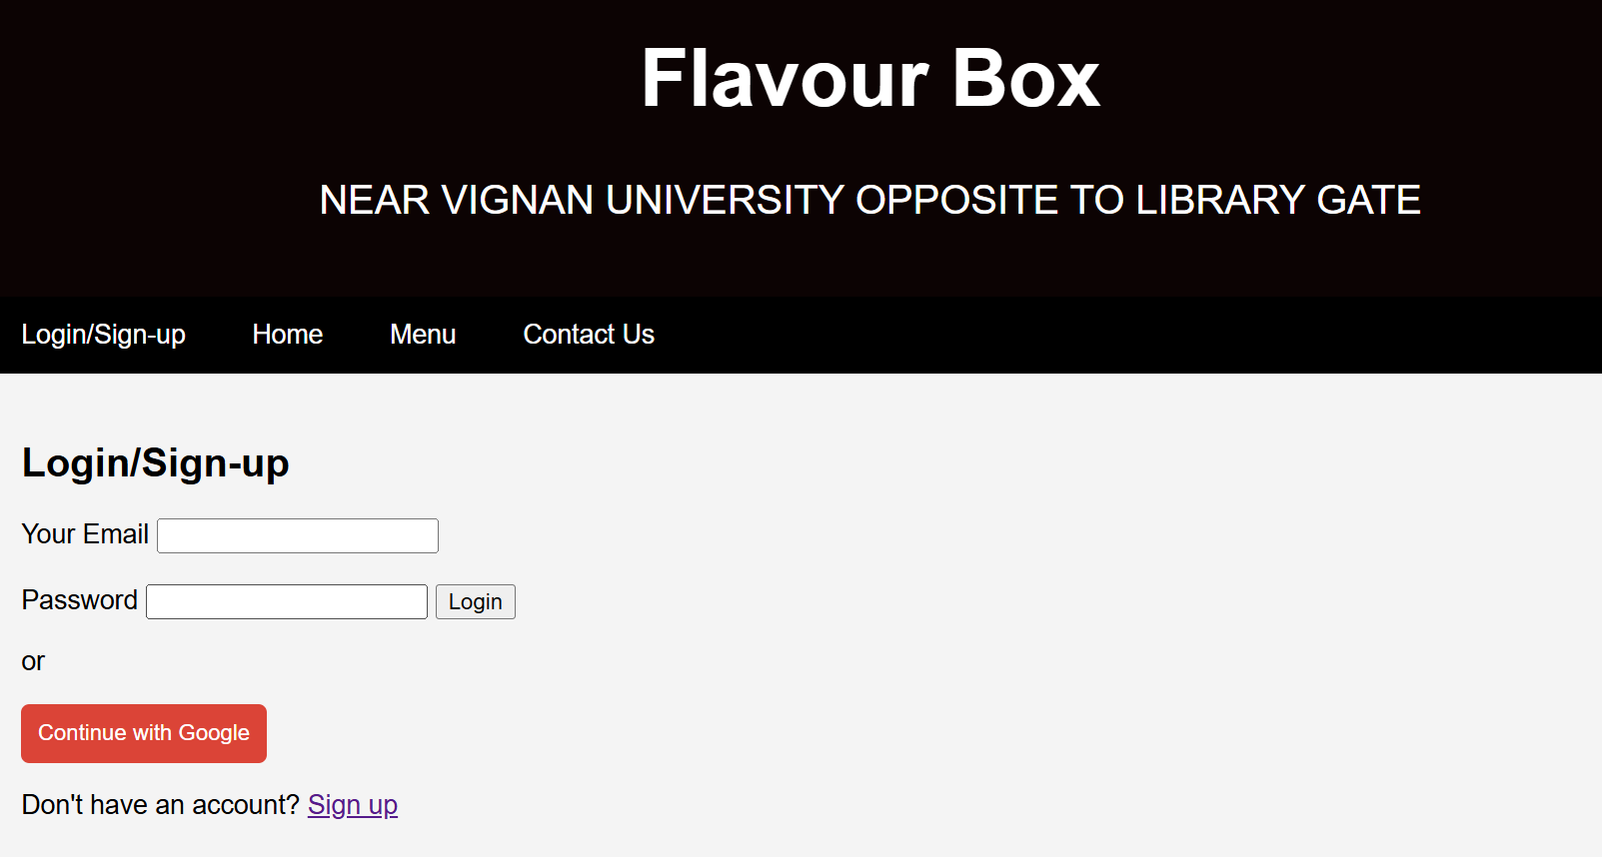
OUTPUT:

Slide 10
CONCLUSION:
In conclusion, the "Flavour Box" online food delivery service website offers a simple yet functional platform for customers to explore and order a variety of delicious food items, including Shawarma, Momos, and Milkshakes. Through the use of HTML, CSS, and JavaScript, the website provides an interactive and responsive user experience, allowing customers to easily navigate between pages, view product options, and submit their orders via a delivery form.
While the website currently serves as a static prototype, it lays the groundwork for a full-fledged online food delivery service. Future enhancements could include backend integration for order processing, user authentication, payment gateway integration, and real-time availability updates, ensuring a more dynamic and complete service.
Overall, "Flavour Box" provides a solid foundation for an online food delivery platform, offering both convenience and variety to users while leaving room for growth and improvements in functionality. With the right additions, it has the potential to become a reliable and customer-friendly service in the competitive online food delivery market.

Slide 11


